Slide 1


Noida Institute of Engineering and Technology, Greater Noida
Advanced Java Programming
AMICSE0601
Unit: III
Spring 5.0
ANKUR CHAUDHARY
Assistant Professor
CSE M.Tech Int.
6th Semester
(CSE M.Tech Int./B.Tech)

Slide 2






Faculty Profile
Responsibilities
COURSERA COORDINATOR
Research Interests
Artificial Intelligence, Machine Learning
Mr. Ankur Chaudhary
Assistant Professor, CSE M.Tech Int.
Education
Ph.D* CSE , GLA University
M.Tech CSE, UTU
B.Tech IT, HNB
Publications
Research Paper: 13
Book Chapter: 2
Patent: 10
Work Exp.
NIET, Gr. Noida (Sept., 2022 to till date)
Assistant Professor

Slide 3
Evaluation Scheme
Sl. No. | Subject Codes | Subject | Periods |  |  | Evaluation Schemes |  |  |  | End Semester |  | Total | Credit | Category Type
 |  |  | L | T | P | CT | TA | TOTAL | PS | TE | PE
1 | AMICSE0601 | Advanced Java Programming | 3 | 0 | 0 | 30 | 20 | 50 |  | 100 |  | 150 | 3 | PCC
2 | AMICSE0602 | Computer Networks | 3 | 1 | 0 | 30 | 20 | 50 |  | 100 |  | 150 | 4 | PCC
3 | AMICSAI0602 | Artificial Intelligence | 3 | 1 | 0 | 30 | 20 | 50 |  | 100 |  | 150 | 4 | PCC
4 |  | Open Elective I | 3 | 1 | 0 | 30 | 20 | 50 |  | 100 |  | 150 | 4 | PCC
5 | AMICSAI0611 | Cloud Storage Management | 3 | 0 | 0 | 30 | 20 | 50 |  | 100 |  | 150 | 3 | ELC
6 | AMICSAI0621 | Big Data | 3 | 0 | 0 | 30 | 20 | 50 |  | 100 |  | 150 | 3 | ELC
7 | AMICSE0652 | Computer Networks Lab | 0 | 0 | 2 |  |  |  | 25 |  | 25 | 50 | 1 | PCC
8 | AMICSE0651 | Advanced Java Programming Lab | 0 | 0 | 2 |  |  |  | 25 |  | 25 | 50 | 1 | PCC
9 | AMICSAI0652 | Artificial Intelligence Lab | 0 | 0 | 2 |  |  |  | 25 |  | 25 | 50 | 1 | PCC
11 | AMICSE0659 | Mini Project | 0 | 0 | 2 |  |  |  | 50 |  |  | 50 | 1 | PW
12 | ANC0602 / ANC0601 | Constitution of India / Essence of Indian Traditional Knowledge | 2 | 0 | 0 |  |  |  |  |  |  |  |  | NC
 |  | MOOCs (For B.Tech. Hons. Degree) |  |  |  |  |  |  |  |  |  |  |  | MOOC
 |  | TOTAL |  |  |  |  |  |  |  |  |  | 1100 | 24

Slide 4
Syllabus
B. TECH. THIRD-YEAR
Course code |  | AMICSE0601 | L T P | Credits
Course title |  | ADVANCED JAVA PROGRAMMING | 3 0 0 | 3
Course objective: Objective of this course is to provide the ability to design console based, GUI based, web based applications, integrated development environment to create, debug and run multi-tier and enterprise-level applications.
Pre-requisites: Basics of C, C++, and basic concept of Core JAVA.
Course Contents / Syllabus
UNIT-I | INTRODUCTION |  |  | 8 Hours
JDBC: Introduction, JDBC Driver, DB Connectivity, Driver Manager, Connection, Statement, Result Set, Prepared Statement, Transaction Management, Stored Procedures. Servlet: Servlet Overview, Servlet API, Servlet Interface, Generic Servlet, HTTP Servlet, Servlet Life Cycle, Redirect requests to other resources, Session Tracking, Event and Listener.
UNIT-II | JSP |  |  | 8 Hours
JSP: Introduction, Overview, JSP Scriptlet Tag, JSP expression Tag, JSP declaration Tag, Life Cycle of JSP, JSP API, Implicit Objects: JSP request, JSP response, JSP config, JSP session, JSP Application, JSP Page Context; JSP Page, JSP Exception.
UNIT-III | Spring 5.0 |  |  | 8 Hours
Spring 5.0: Spring Core Introduction and Overview, Managing Beans, The Spring Container, The Factory Pattern, Dependency Injection (DI), Spring Managed Bean Lifecycle, Constructor Injection, Metadata/ Configuration: Life Cycle Annotations, Java Configuration, XML Free configuration.

Slide 5
Syllabus
UNIT-IV |  | Spring MVC & Spring Boot |  | 8 Hours
Spring MVC: Introduction/Developing Web Application with Spring MVC, Advanced Techniques, Spring Controllers Spring Boot: Spring Boot Starters, CLI, Application Class, Logging, Auto Configuration Classes, Spring Boot dependencies, Spring data JPA introduction and Overview.
UNIT-V |  | JPA |  | 8 Hours
JPA: Introduction & overview of data persistence, Overview of ORM tools, Understanding JPA, Entities: Requirement for Entity Class, Persistent Fields and Properties, Primary keys in Entries, Entity Management,Querying Entities, Entities Relationships.
Course outcome: After completion of this course students will be able to
CO 1 | Understand the concept of implementing the connection between Java and Database using JDBC. |  | K2,K4
CO 2 | Understand, Analyse, and Build dynamic web pages for server-side programming |  | K2,K3
CO 3 | Analyze and design the Spring Core Modules and DI to configure and wire beans (application objects) together |  | K4,K5
CO 4 | Design Model View Controller architecture and ready components that can be used to develop flexible and loosely coupled web applications. |  | K2,K3.K6
CO 5 | Deploy JPA to Map, store, retrieve, and update data from java objects to relational databases and vice versa. |  | K5

Slide 6
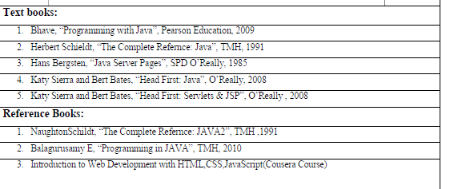
Syllabus
NPTEL/ YouTube/ Faculty Video Link:
Unit1
https://youtu.be/96xF9phMsWA
https://youtu.be/Zopo5C79m2k
Unit 2 https://youtu.be/vHmUVQKXlVo
https://youtu.be/qz0aGYrrlhU
Unit 3 https://youtu.be/GBOK1-nvdU4
https://youtu.be/YpsFT50mths?list=PLd3UqWTnYXOlc93disyBjyFv-r1Vq-5zh
Unit 4 https://youtu.be/-qfEOE4vtxE
https://youtu.be/PkZNo7MFNFg
Unit 5 https://youtu.be/_GMEqhUyyFM
https://youtu.be/ImtZ5yENzgE

Slide 7
Branch wise Applications
Desktop GUI Applications
Mobile Applications
Artificial intelligence
Web applications
Big Data technology
Gaming applications
Business applications
Embedded systems
Cloud applications
Scientific applications

Slide 8
Course Objective
Objective of this course is to provide the ability to design console based, GUI based, web based applications, integrated development environment to create, debug and run multi-tier and enterprise-level applications.
To design and develop the dynamic web sites using, Servlet and jsp.
To understand the concept of business logic to develop the enterprises application by Spring framework.
To apply the MVC design pattern in developing a live project.
To learn the concept of database handling in java and apply this concept in transactional processing based project.

Slide 9


Course Outcomes
Course outcomes : After completion of this course students will be able to
CO 1 | Understand the concept of implementing the connection between Java and Database using JDBC. | K2,K4
CO 2 | Understand, Analyse, and Build dynamic web pages for server-side programming | K2,K2
CO 3 | Analyze and design the Spring Core Modules and DI to configure and wire beans (application objects) together | K4,K5
CO 4 | Design Model View Controller architecture and ready components that can be used to develop flexible and loosely coupled web applications. | K2,K3,K6
CO 5 | Deploy JPA to Map, store, retrieve, and update data from java objects to relational databases and vice versa. | K5

Slide 10
Program Outcome
1. Engineering knowledge
2. Problem analysis
3. Design/development of solutions
4.Conduct investigations of complex problems
5. Modern tool usage
6. The engineer and society
7. Environment and sustainability
8. Ethics:
9. Individual and team work
10. Communication
11. Project management and finance
12. Life-long learning

Slide 11
CO-PO Mapping
Mapping of Course Outcomes and Program Outcomes:
CODE | PO1 | PO2 | PO3 | PO4 | PO5 | PO6 | PO7 | PO8 | PO9 | PO10 | PO11 | PO12
ACSE0601.1 | 3 | 3 | 2 | 3 | 3 | 3 | 2 | 3 | 3 | 3 | 2 | 3
ACSE0601.2 | 3 | 2 | 3 | 2 | 3 | 2 | 2 | 2 | 3 | 3 | 3 | 3
ACSE0601.3 | 3 | 3 | 3 | 2 | 3 | 3 | 2 | 3 | 3 | 3 | 2 | 3
ACSE0601.4 | 3 | 3 | 3 | 2 | 3 | 3 | 2 | 3 | 3 | 3 | 3 | 3
ACSE0601.5 | 3 | 3 | 3 | 2 | 3 | 2 | 2 | 3 | 3 | 3 | 3 | 3
Average | 3 | 2.8 | 2.8 | 2.2 | 3 | 2.6 | 2 | 2.8 | 3 | 3 | 2.6 | 3

Slide 12
Program Specific Outcomes (PSO)
PSO: After completion of this course students will be able to
PSO 1 | Work as a software developer, database administrator, tester or networking engineer for providing solutions to the real world and industrial problems.
PSO 2 | Apply core subjects of information technology related to data structure and algorithm, software engineering, web technology, operating system, database and networking to solve complex IT problems.
PSO 3 | Apply core subjects of information technology related to data structure and algorithm, software engineering, web technology, operating system, database and networking to solve complex IT problems.
PSO4 | Work in a team or individual to manage projects with ethical concern to be a successful employee or employer in IT industry.

Slide 13
CO-PSO Mapping
Mapping of Course Outcomes and Program Specific Outcomes:
CO.k | PSO1 | PSO2 | PSO3 | PSO4
ACSE0601.1 | 3 | 3 | 2 | 3
ACSE0601.2 | 3 | 3 | 3 | 2
ACSE0601.3 | 3 | 3 | 2 | 2
ACSE0601.4 | 3 | 2 | 3 | 2
ACSE0601.5 | 3 | 2 | 2 | 2
AVG | 3 | 2.6 | 2.4 | 2.2
3= High, 2=Medium, 1=Low

Slide 14
Program Educational Objectives (PEO)
PEO: After completion of this course students will be able to
PEO 1 | able to apply sound knowledge in the field of information technology to fulfill the needs of IT industry.
PEO 2 | able to design innovative and interdisciplinary systems through latest digital technologies.
PEO 3 | able to inculcate professional and social ethics, team work and leadership for serving the society.
PEO 4 | able to inculcate lifelong learning in the field of computing for successful career in organizations and R&D sectors.

Slide 15
End Semester Question paper Templates
 |  | SECTION – A |  | CO
 | Attempt all parts- |  | [10×1=10]
 | 1-a. | Question- | (1)
 | 1-b. | Question- | (1)
 | 1-c. | Question- | (1)
 | 1-d. | Question- | (1)
 | 1-e. | Question- | (1)
 | 1-f. | Question- | (1)
 | 1-g. | Question- | (1)
 | 1-h. | Question- | (1)
 | 1-i. | Question- | (1)
 | 1-j. | Question- | (1)
2. | Attempt all parts- |  | [5×2=10] | CO
 | 2-a. | Question- | (2)
 | 2-b. | Question- | (2)
 | 2-c. | Question- | (2)
 | 2-d. | Question- | (2)
 | 2-e. | Question- | (2)

Slide 16
End Semester Question paper Templates
SECTION – B |  |  |  | CO
3. | Answer any five of the following- |  | [5×6=30]
 | 3-a. | Question- | (6)
 | 3-b. | Question- | (6)
 | 3-c. | Question- | (6)
 | 3-d. | Question- | (6)
 | 3-e. | Question- | (6)
 | 3-f. | Question- | (6)
 | 3-g. | Question- | (6)
SECTION – C |  |  |  | CO
4 | Answer any one of the following- |  | [5×10=50]
 | 4-a. | Question- | (10)
 | 4-b. | Question- | (10)
5. | Answer any one of the following-
 | 5-a. | Question- | (10)
 | 5-b. | Question- | (10)
6. | Answer any one of the following-
 | 6-a. | Question- | (10)
 | 6-b. | Question- | (10)
7. | Answer any one of the following-
 | 7-a. | Question- | (10)
 | 7-b. | Question- | (10)
8. | Answer any one of the following-
 | 8-a. | Question- | (10)
 | 8-b. | Question- | (10)

Slide 17
Result Analysis
NA

Slide 18
Prerequisite and Recap
Prerequisite:
Basics of C, C++, and basic concept of Core JAVA.
Recap:
Previous concept was focused on object oriented programming.
The main concepts has been discussed about core java functionalities
In core java we have discussed about class, interface, exception handling, multi-threading, collections, etc.

Slide 19
Brief Introduction about the Subject with videos
Advance Java Programming provides libraries to understand the concept of Client-Server architecture for web- based applications.
We can also work with web and application servers such as Apache Tomcat and Glassfish Using these servers, we can understand the working of HTTP protocol.
It provides a set of services, API and protocols, that provides the functionality which is necessary for developing multi-tiered application, web-based application.
There is a number of advance Java frameworks like, Spring, Hibernate, Struts, that enables us to develop secure transaction-based web applications such as banking application, inventory management application.
YouTube/other Video Links
https://youtu.be/6grF7_VzlZk?list=PLnfapp4Woqpqh_ebAN5mEZWrN4BjaoL_S https://youtu.be/YpsFT50mths?list=PLd3UqWTnYXOlc93disyBjyFv-r1Vq-5zh

Slide 20
Unit Contents
Spring 5.0:
Spring Core Introduction and Overview
Managing Beans
The Spring Container
The Factory Pattern
Dependency Injection (DI)
Spring Managed Bean Lifecycle
Constructor Injection
Metadata/ Configuration: Life Cycle Annotations
Java Configuration
XML Free configuration.

Slide 21
Unit Objective
The objective of the unit is
To understand the Spring Framework and use its capabilities.
Students will learn about the spring core- dependency injection (DI), bean lifecycle management.
Understanding the Spring configuration and API for writing Spring programs.
Learn about the XML, Java based, and annotation-based config

Slide 22
Framework
Frameworks are large bodies (usually many classes) of prewritten code to which you add your own code to solve a problem in a specific domain.
A framework uses your code because it is usually the framework that drives the control flow. Developers make use of a framework by calling its methods, by inheriting, or supplying "callbacks“.
Generally Framework is provided as jar file(s)
For eg:
GUI Framework – Swing and AWT(part of JDK)
Other third party Java Frameworks
Hibernate – ORM (object relational mapping) Framework or Object persistence Framework
Spring – General purpose Framework
Struts – MVC Framework

Slide 23
Web Framework
A web framework is a software framework designed to simplify your web development life.
• Frameworks exist to save you from having to re-invent the wheel and help alleviate some of the overhead when building a new site.
• Sessions and cookies
• Rest
• Database
• Template engines

Slide 24
Topic Objective
The objective of the topic is
To provide an understanding of why we need the Spring Framework.

Slide 25
Need of Spring Framework
Enterprise apps have complex requirements, including
Many application types and dependencies
Persistent data and transactions
Remote clients (REST, WebService, others)

Slide 26
Topic Objective
The objective of the topic is
To understand the Spring advantages over other framework

Slide 27
Spring: An Introduction
The Spring Framework is a lightweight solution and a potential one-stop-shop for building your enterprise-ready applications.
However, Spring is modular, allowing you to use only those parts that you need, without having to bring in the rest
The Spring Framework supports declarative transaction management, remote access to your logic through RMI or web services, and various options for persisting your data.
It offers a full-featured MVC framework, and enables you to integrate AOP transparently into your software.
Spring is designed to be non-intrusive, meaning that your domain logic code generally has no dependencies on the framework itself.

Slide 28
Spring: Advantages
Lead by pivotal
• Open source application
• Plugins and support for most web technologies
• Loads of utility API-s

Slide 29
Spring: Advantages
Free
• Easy to use
• No XML anymore
• Extremely popular
• Java, Groovy and Kotlin support
• Good for cloud and microservices

Slide 30
DAILY QUIZ 1
Spring is licensed under
GNU
Apache License 2.0
GNU Lesser General Public License
Open source
2. Spring is developed by
Red Hat Software
Daniel Fernández
Apache
Pivotal Software
3. Who invented Spring? Rod Johnson
4. Spring is what kind of component? (Lightweight/ Heavyweight)

Slide 31
Topic Objective
The objective of the topic is
To understand architecture of Spring and Spring Container

Slide 32
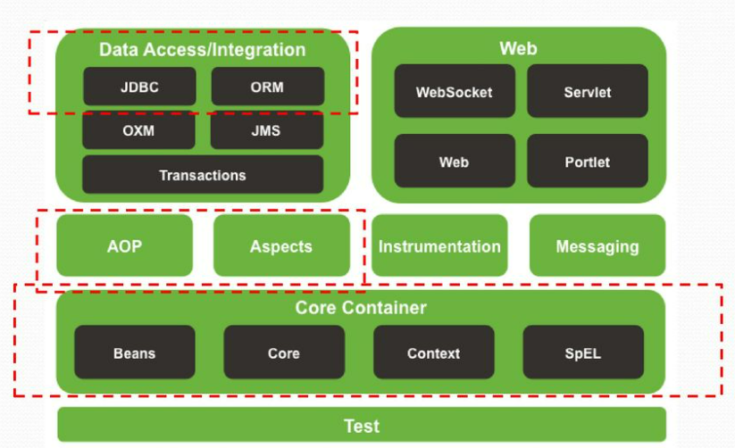
Spring Architecture
Source:
https://spring.io/

Slide 33
Spring Framework Components
Inversion of control container : Configuration of application components and lifecycle management of java objects.
Aspect-oriented programming : Enables implementation of cross-cutting routines.
Data access : Working with relational database management systems on the java platform using JDBC and object-relational mapping tools.
Transaction management : Unifies several transaction management APIs and coordinates transactions for Java objects.
Model-View-Controller : An HTTP and Servlet-based framework providing hooks for extension and customization.
Remote Access Framework : Configurative RPC-style export and import of java objects over networks supporting RMI, CORBA and HTTP-based protocols including the web services (SOAP).

Slide 34
Spring Framework Components
Batch processing : A framework for high-volume processing featuring reusable functions including logging/tracing, transaction management, job processing statistics, job restart, skip, and resource management. Eg. Generation of Pay Slips
Authentication and authorization : Configurable security processes that support a range of standards, protocols, tools and practices via the Spring Security sub-project
Remote Management : Configurative exposure and management of java objects for local or remote configuration via JMX.
Messaging : Configurative registration of message listener objects for transparent message consumption from message queues via JMS, improvement of message sending over standard JMS APIs.
Testing : Support classes for writing unit tests and integration tests.

Slide 35
DAILY QUIZ 2
Spring’s data access module provides out-of-the-box support for
JDBC
JDO, Hibernate
JPA
All of the above
2. The core of the Spring Framework is based on the principle of
DOC
JNDI
IOC
XML
3. Which spring module provides the capability of DI or IOC? (Core Container/AOP)
4. What are beans in the concept of Spring or what are spring beans?
Repository/ Any class that is managed by the container.

Slide 36
Topic Objective
The objective of the topic is
To provide an understanding for Dependency Injection

Slide 37
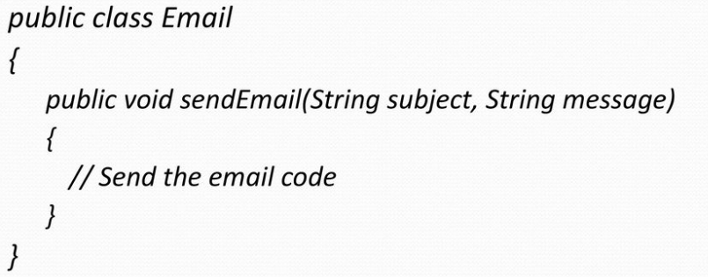
Dependency Injection
Dependency injection is a framework that takes care of creating objects for us without having to worry about providing the right ingredients or parameters.
So, from where ever you want to send an email , you can create an object of Email class, and invoke sendEmail() method. There may be hundred or even more places from where you may do it, from your App.

Slide 38
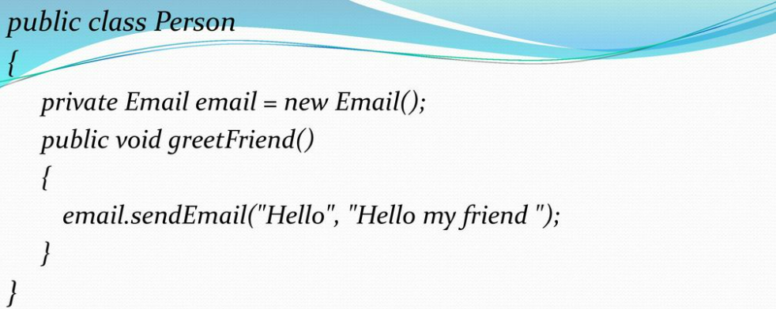
Dependency Injection
We write above code, when we want to send an from Person class. We all agree that this is a very simple and straightforward example that involves two simple Java classes. Nevertheless, the above has some limitations as described below.

Slide 39
Disadvantages of this Approach are…
The Person class is dependent (has a strong/tight dependency) on the class.
There is a hard connection between these two classes.
Let say we have a new and better version of email class, FastEmail , in order for us to use it, we need to go in each and every class that depends on the Email class, such as the Person class, and replace it with the new version.
Let say we parameterize the Email‘s constructor. Again we have to go in each and every class that is initializing the Email class, such as the Person class, and change it. A design decision is taken to make the class Singleton. Similar to above we need to modify all instances where it is used.

Slide 40
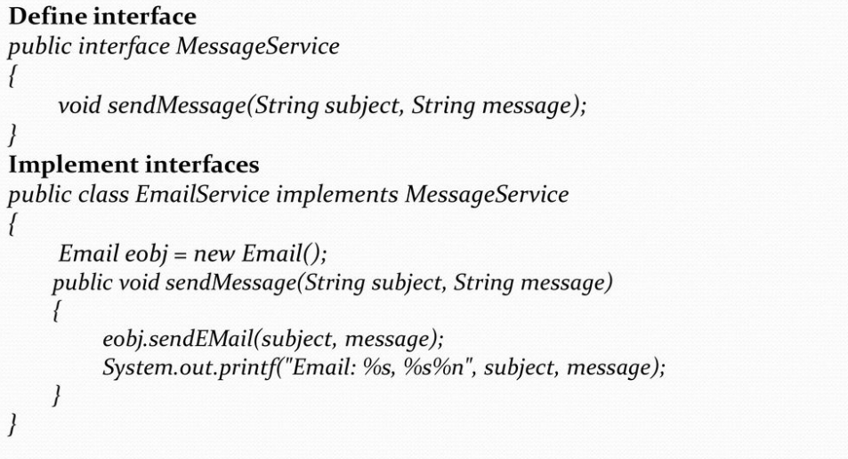
Better Design
The Email class provides a service, that is, sending of messages over the Internet using the mail protocol. Instead of having the Person class initializing an instance of the Email class, we first create an interface, MessageService, and make the Person class using this interface instead. This removes the tight dependency that the Person class has on the Email and replaces it with an abstract message delivery interface.

Slide 41
Better Design
The Email class provides a service, that is, sending of messages over the Internet using the mail protocol. Instead of having the Person class initializing an instance of the Email class, we first create an interface, MessageService, and make the Person class using this interface instead. This removes the tight dependency that the Person class has on the Email and replaces it with an abstract message delivery interface.

Slide 42
How Dependency Injection is advantageous?
Note that the Person class is not initializing the message service but it is expecting it as a parameter of its constructor.
This is a key element in the design. It improves modularity, extendibility and testing.
The Person class is not dependent on any implementation, but on a service defined by an interface. This means that we can use the Person class without having to worry about the underlying implementation of the message service.
Furthermore, different Person instances can be instantiated using different message services.
Best Eg. Comparator object sent as parameter to TreeSet or TreeMap

Slide 43
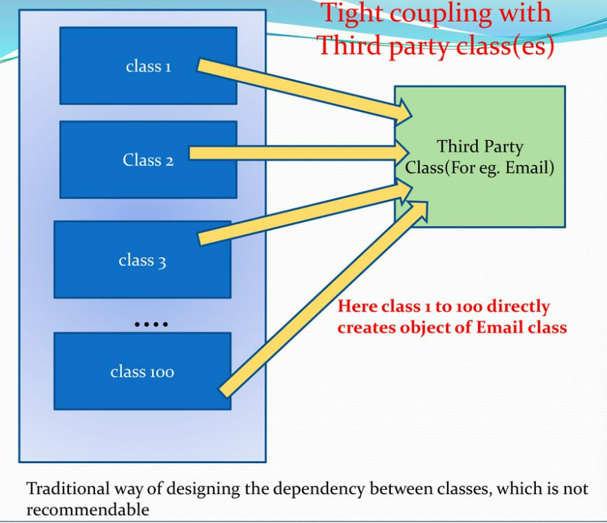
How Dependency Injection is advantageous?
Dependency Injection can help us initializing objects and provide these objects all the necessary resources (ingredients).
For example, the Person class requires an instance of MessageService.
The dependency injection framework will provide that for us.
Spring's Dependency Injection functionality is implemented using this BeanFactory interface

Slide 44
DAILY QUIZ 3
Benefits of DI is
Reduced glue code
Simplified application configuration and improved testability
Ability to manage common dependencies
ALL
2. Spring’s DI implementation is based around two core java concepts
JavaBeans/Interfaces
Java Object
Method
3. Which spring module provides the capability of DI or IOC?
Spring web
Core container
AOP
Data access
4. How does spring achieve DI or IOC?
Service locator pattern/ Factory pattern

Slide 45
Topic Objective
The objective of the topic is to provide a brief about Inversion of Control (IoC) used in DI.

Slide 46
Inversion of Control (IoC)
Inversion of Control (IoC) means that objects do not construct other objects on which they rely on.
Instead, the application will get these objects from an external framework (an IoC container).
One method which provides these objects to the application is called Dependency Injection (DI), another is Factory Pattern .

Slide 47
Why previous tight dependency is not preferred?
If third party class need to be replaced, later due to Business or Technical reasons, all the classes directly dependent on this class, need to be changed, and again Tested, etc… which is time consuming and shoots up cost of Project.
This tight dependency can be avoided, by using Dependency Injection Framework such as Spring, as shown in next diagram

Slide 48
Topic Objective
The objective of the topic is to understand working of DI with Spring Framework (Spring Beans)

Slide 49
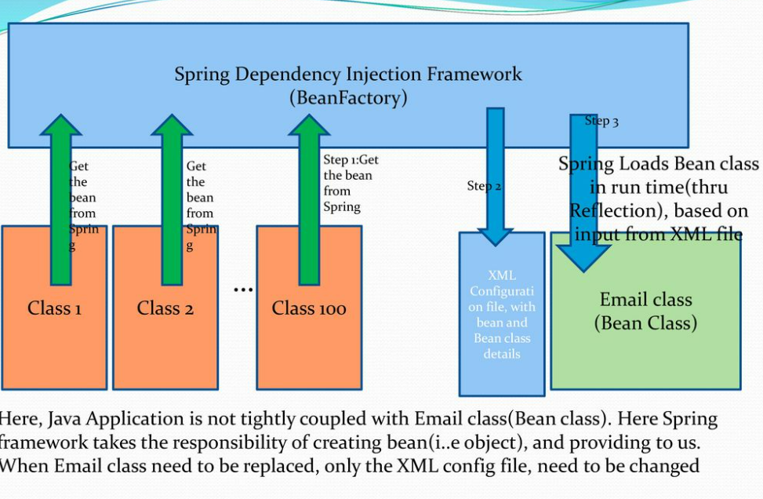
Spring Managed Bean Lifecycle

Slide 50
Contd…….
Dependency Injection helps in gluing these classes together and at same time keeping them independent.
What is dependency injection exactly?
Here the dependency part translates into an association between two classes.
For example, class A is dependent on class B. Now, let's look at the second part, injection.
All this means is that class B will get injected into class A by Dependency Injection Framework(such as Spring).
Dependency Injection is the heart or Core of Spring Framework.

Slide 51
Contd…….
In Spring Framework, there are two ways to inject a Bean
by passing parameters to the constructor or by post-construction using setter methods.
Combination of parameters through constructor and setter method.

Slide 52
Spring bean
A bean is an object that is instantiated, assembled, and otherwise managed by a Spring DI Framework.
These beans are created with the configuration metadata that you supply to the container, for example, in the form of XML <bean/>
For example, an object an Employee class
(which is created by BeanFactory) is a bean.

Slide 53
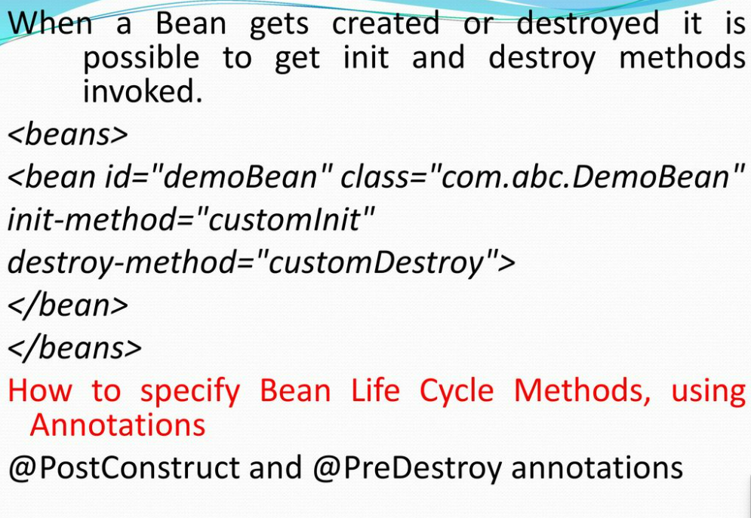
Bean Life Cycle Methods

Slide 54
DAILY QUIZ 4
IOC is
Java Bean
Depend on DI
A framework
Externalize the management of component dependencies
2. What are beans in the concept of Spring or what are spring beans?
Controller classes
Service classes
Repository
Any class that is managed by the container
.3. What is bean in Spring?
A component
An object
A class
A container
4. Which element is used to specify access attributes for bean’s methods.
security:protect/security:intercept

Slide 55
Topic Objective
The objective of the topic is to understand about Constructor Injection, Setter method, Dependent Object thru Setter method, dynamic inject values to Bean.

Slide 56
Constructor Injection
The dependency is injected by constructor.
The <constructor-arg> sub element of <bean> is used for constructor injection.
Here we are going to inject
primitive and String-based values
Dependent object (contained object)
Collection values etc.

Slide 57
Dependency Injection by Setter method
We can inject the dependency by setter method also.
The <property> sub element of <bean> is used for setter injection.
Here we are going to inject
primitive and String-based values
Dependent object (contained object)Collection values etc.

Slide 58
Injecting Dependent Object thru Setter method
When one Object is dependent on another, this approach can be used to set one object to another object, thru setter method. We use property element, for this.

Slide 59
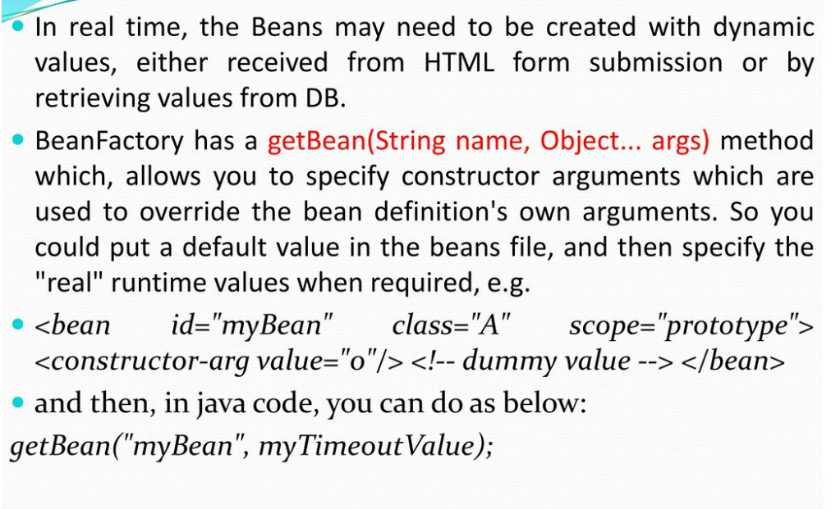
Dynamically Inject values to Bean

Slide 60
Topic Objective
The objective of the topic is to understand about Spring DI with Collections

Slide 61
Spring DI with Collections
A Bean can be injected with any Collection, such as
List
Set
Map
For Medium to large Spring-based applications, it’s common to break Spring’s application context file into multiple files.
This improves modularity of the application, and improves maintainability.
Spring allows multiple config files by providing the <import> element.

Slide 62
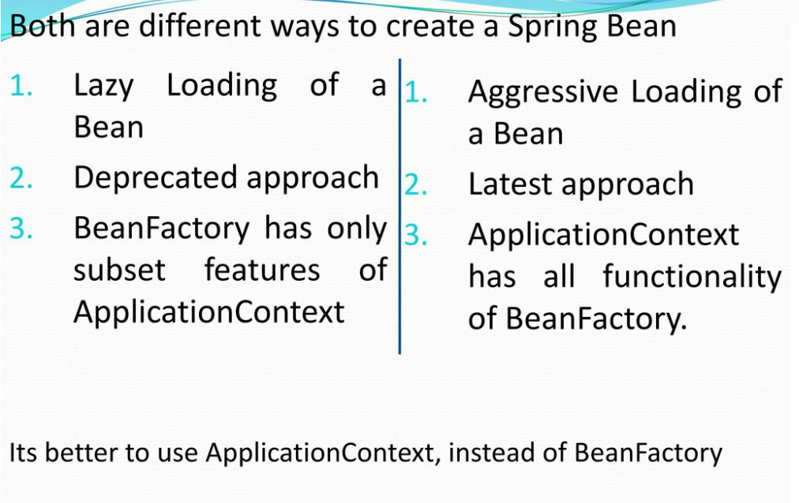
BeanFactory & ApplicationContext Difference

Slide 63
DAILY QUIZ 5
What are the different ways to configure a Spring application?
Traditional XML based, Annotation
2. What is default scope of bean in Spring framework?
Singleton
Prototype
Request
Session
3. By default a bean is eagerly loaded. (T/F)
4. Thread Scoped Bean Is Introduced In Which Version Of Spring Framework.
1.0
2.0
3.0
4.0

Slide 64
Topic Objective
The objective of the topic is to understand about Application Context and Annotations.

Slide 65
ApplicationContext
Below are most commonly used ApplicationContexts
FileSystemXmlApplicationContext: This loads the definitions of the beans from an XML file. Here you need to provide the full path of the XML bean configuration file to the constructor.
ClassPathXmlApplicationContext: This loads the definitions of the beans from an XML file. Here you do not need to provide the full path of the XML file but you need to set CLASSPATH properly because this container will look bean configuration XML file in CLASSPATH.
WebXmlApplicationContext: This loads the XML file with definitions of all beans from within a web application.

Slide 66
SpringBean with Annotations
Annotations, which need to be used are
@Configuration
@Value – to inject a primitive value
@Resource – to inject non primitive value

Slide 67
Spring AutoScan Components
Normally all the beans or components need to be declared in XML bean configuration file, so that Spring container can detect and register your beans or components.
Actually, Spring is able to auto scan, detect and instantiate your beans from pre-defined project package, no more tedious beans declaration in in XML file.
Auto Components Scan Annotation Types
In Spring , there are 4 types of auto components scan annotation types
@Component – Indicates a auto scan component.
@Repository – Indicates DAO component in the persistence layer.
@Service – Indicates a Service component in the business layer.
@Controller – Indicates a controller component in the presentation layer.
For readability, you should always declare auto components for a specified layer to make your code more easier to read.

Slide 68
Spring AutoScan Components
In Spring, bean scope is used to decide which type of bean instance should be return from Spring container back to the caller.
5 types of bean scopes supported :
singleton – Return a single bean instance per Spring IoC container
prototype – Return a new bean instance each time when requested
request – Return a single bean instance per HTTP request*.
session – Return a single bean instance per HTTP session. *
globalSession – Return a single bean instance per global HTTP session. *

Slide 69
Topic Objective
The objective of the topic is to understand the difference between XML and Annotation.

Slide 70
Difference between XML and Annotation
Spring Configs can be done with Annotations or XML.
Below are differences of using either of them.
Code Readability is better, by using Annotations, since all mapping details are specified along with Bean class.
Rebuild/Recompile of source code is not required, when any changes are made to XML Config file, where as any changes to Annotations needs re building of code.

Slide 71
Spring Auto Wiring
Autowiring feature of spring framework enables you to inject the object dependency implicitly.
It internally uses setter or constructor injection.
Autowiring can't be used to inject primitive and string values.
It works with reference only.
Advantage of Autowiring
It requires the less code because we don't need to write the code to inject the dependency explicitly.
Disadvantage of Autowiring
No control of programmer, and reduces readability, which may cause side effects during maintenance. It can't be used for primitive and string values.
Spring Auto Wiring Models
byName, byType

Slide 72
DAILY QUIZ 6
What Are Different Types Of Autowire?
All of the below
Autodetect
byName
byType
2. Which is the way to provide configuration metadata to spring?
XML based configuration file
Annotation based configuration
Java based configuration
All
3. What is Target object?
This is used to inject values in objects.
The object being advised by one or more aspects, this object will always be a proxy object, also referred to as the advised object.
4. Which module is needed for every spring application?
Bean, Jdbc, core, orm

Slide 73
Topic Objective
The objective of the topic is to understand about Spring XML and JAVA configuration

Slide 74
Spring XML configuration
Create a simple java maven project.
Maven dependency
put spring and cglib maven dependency in pom.xml.
Create Bean class
Create a bean class called Country.java in package org.arpit.java2blog.model
ApplicationContext.xml
Create ApplicationContext.xml in src/main/resources as below.
Create SpringXMLConfigurationMain.java
Create a class named "SpringXMLConfigurationMain.java" in org.arpit.java2blog package.
Create SpringXMLConfigurationMain.java
Create a class named "SpringXMLConfigurationMain.java" in org.arpit.java2blog package.

Slide 75
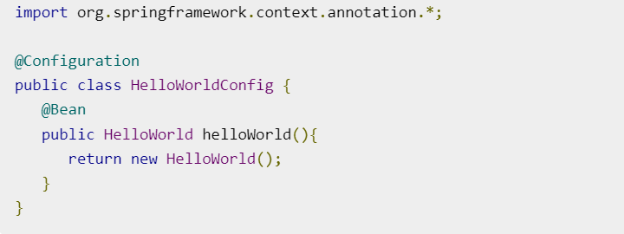
Spring - Java Based Configuration
Annotating a class with the @Configuration indicates that the class can be used by the Spring IoC container as a source of bean definitions. The @Bean annotation tells Spring that a method annotated with @Bean will return an object that should be registered as a bean in the Spring application context. The simplest possible @Configuration class would be as follows:
The above code will be equivalent to the following XML configuration −
<beans> <bean id = "helloWorld" class = "HelloWorld" /> </beans>

Slide 76
Spring - Java Based Configuration
Steps | Description
1 | Create a project with a name SpringExample and create a package com.example under the src folder in the created project.
2 | Add required Spring libraries using Add External JARs option as explained in the Spring Hello World Example chapter.
3 | Because you are using Java-based annotations, so you also need to add CGLIB.jar from your Java installation directory and ASM.jar library which can be downloaded from asm.ow2.org.
4 | Create Java classes HelloWorldConfig, HelloWorld and MainApp under the com.tutorialspoint package.
5 | The final step is to create the content of all the Java files and Bean Configuration file and run the application as explained below.

Slide 77
WEEKLY ASSIGNMENT
What do you mean by Framework?
Define Dependency Injection.
In Spring config file which is the root element.
How many <bean> elements can be there in a <beans> root element
An example Spring Config XML file of DI thru Constructor and thru Setter?
Can we have combination of DI thru Constructor and Setter?
How to specify Spring Bean using Annotation?
Different Scope attribute values?
Advantage of DI?
How to Inject a Collection to a Bean?

Slide 78
Faculty Video Links, Youtube & NPTEL Video Links and Online Courses Details
https://youtu.be/6grF7_VzlZk?list=PLnfapp4Woqpqh_ebAN5mEZWrN4BjaoL_S https://www.youtube.com/watch?v=vC5O5nDCYBU&list=PLd3UqWTnYXOlc93disyBjyFv-r1Vq-5zh&index=2
https://youtu.be/6grF7_VzlZk?list=PLnfapp4Woqpqh_ebAN5mEZWrN4BjaoL_S

Slide 79
MCQ
1. Which of the following method is used to gracefully shutdown all the bean processes after closing the spring container?
destory method
shutdownHook
session method
None of these
2. What is the scope of bean in portlet context?
session
global-session
request
prototype

Slide 80
MCQ
3.What is the default scope of the beans?
Prototype
session
Request
Singleton
4. How to use <ref> in spring framework?
is used with bean id
is used with string values
All of the above

Slide 81
MCQ
5. AOP stands for?
Asynchronous oriented programming
Aspect Oriented Programming
All Oops Program
None
6. How many types of method injection are available in spring?
4
2
8
1

Slide 82
MCQ
7. In spring method that allows you to start a new transaction is called
commit()
getTransaction()
rollback()
None of the above
8. Annotation which decorates the PostageServiceBean is
@Autowire
@Interceptors
@Wire
@Mention

Slide 83
MCQ
11. What are the ioc container in Spring?
BeanFactory
ApplicationContext
Both BeanFactory & ApplicationContext
None of the above
12. The Spring support classes facilitate building session beans:
stateful session beans (SFSBs)
message-driven beans (MDBs)
stateless session beans (SLSBs)
All of the above

Slide 84
MCQ
9. To declare a JNDI object reference in the Spring IoC container.
JndiObject
JndiObjectFactory
JndiObjectFactoryBean
JndiFactoryBean
10. Select the bean scope.
Bean scope defines the accessibility of bean in a java class.
Bean scope defines the accessibility of bean in a java package
Bean scope defines the accessibility of bean in a web application.
Bean scope forces Spring to produce a new bean instance as per the scope defined.

Slide 85
Expected Questions
What if you don’t have matching constructor or Setter method?
Difference between XML and XSD file?
Different JSP Tags?
Which is Core functionality of Spring?
How to use Multiple Spring Config files?
Purpose of ref attribute in bean element, in Spring Config file?
Only one Spring XML Config file can exist, in a project.Spring XML Config file need to be always named as ApplicationContext.xml.
Write a program to display Spring annotations.
Write the program in spring to inject primitive and string-based values using Constructor Injection.
Create the First Spring Application using eclipse/other framework and print the value from XML.

Slide 86
Recap/ Summary
Discussed about key concepts of Spring Framework
About the Spring Container
Discussed about the Dependency Injection (DI)
Spring Managed Bean Lifecycle
Constructor Injection
Metadata/ Configuration: Life Cycle Annotations
Java Configuration, XML Free configuration.

Slide 87
References
Bhave, “Programming with Java”, Pearson Education, 2009
Herbert Schieldt, “The Complete Refernce: Java”, TMH, 1991
Hans Bergsten, “Java Server Pages”, SPD O’Really, 1985
Katy Sierra and Bert Bates, “Head First: Java”, O’Really, 2008
Katy Sierra and Bert Bates, “Head First: Servlets & JSP”, O’Really , 2008
NaughtonSchildt, “The Complete Refernce: JAVA2”, TMH ,1991
Balagurusamy E, “Programming in JAVA”, TMH, 2010
Introduction to Web Development with HTML, CSS, JavaScript (Cousera Course)

Slide 88
Noida Institute of Engineering and Technology, Greater Noida
THANK YOU !!

